Slide 1
Kubernetes system for automating deployment, scaling, and management of containerized applications
Panyushin Daniil Vasilevich
19B12-пу

Slide 2
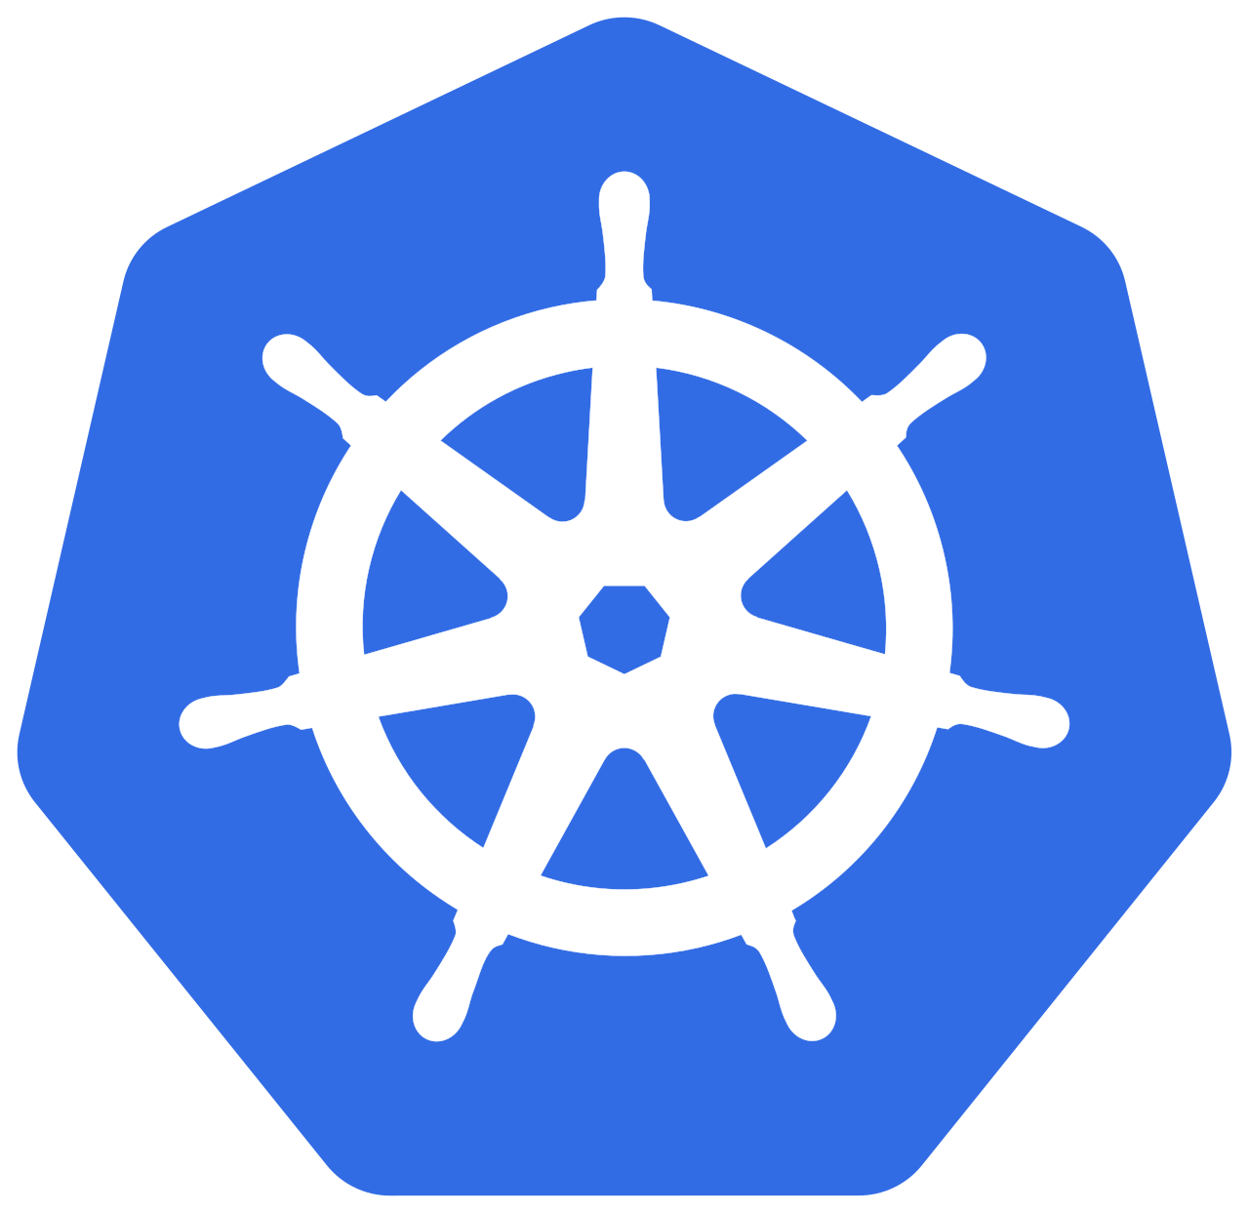
What is Kubernetes?
Kubernetes (also known as K8s) is a portable, extensible, open source platform for managing containerized workloads and services, that facilitates both declarative configuration and automation. It has a large, rapidly growing ecosystem. Kubernetes services, support, and tools are widely available.
It was designed by Google and now it is maintained by the Cloud Native Computing Foundation.
K8s was released in July 21, 2015.
Notes:
Kubernetes (also known as K8s) is a portable, extensible, open source platform for managing containerized workloads and services, that facilitates both declarative configuration and automation. It has a large, rapidly growing ecosystem. Kubernetes services, support, and tools are widely available.
It was designed by Google and now it is maintained by the Cloud Native Computing Foundation. Kubernetes combines over 15 years of Google's experience running production workloads at scale with best-of-breed ideas and practices from the community.
First version was released on July 21, 2015.

Slide 3
Why we need Kubernetes and what it can do?
Service discovery and load balancing
Storage orchestration
Automated rollouts and rollbacks
Automatic bin packing
Self-healing
Secret and configuration management
Notes:
Containers are a good way to bundle and run applications. In a production environment, it’s necessary to manage the containers that run the applications and ensure that there is no downtime.
Kubernetes takes care of:
Service discovery and load balancing Kubernetes can expose a container using the DNS name or using their own IP address. Kubernetes is able to load balance and distribute the network traffic so that the deployment is stable.
Storage orchestration Kubernetes allows us to automatically mount a storage system of our choice, such as local storages, public cloud providers, and more.
Automated rollouts and rollbacks Kubernetes can change the actual state to the desired state at a controlled rate. For example, we can automate Kubernetes to create new containers or remove existing for our deployment.
Automatic bin packing We can tell Kubernetes how much CPU and memory each container needs and they would be setup to make the best use of our resources.
Self-healing Kubernetes restarts containers that fail, replaces containers, kills containers that don't respond to user-defined health check, and doesn't advertise them to clients until they are ready to serve.
Secret and configuration management Kubernetes lets us store and manage sensitive information, such as passwords, OAuth tokens, and SSH keys.

Slide 4
What K8s is not?
It does not limit the types of applications supported.
It does not deploy source code and does not build our application.
It does not provide application-level services, such as middleware, data-processing frameworks, databases, caches, nor cluster storage systems as build-in services.
It does not dictate logging, monitoring, or alerting solutions.
It does not provide nor mandate a configuration language/system.
It does not provide nor adopt any comprehensive machine configuration, maintenance, management, or self-healing systems.
Notes:
Kubernetes:
Does not limit the types of applications supported. Kubernetes aims to support an extremely diverse variety of workloads. If an application can run in a container, it should run great on Kubernetes.
Does not deploy source code and does not build our application. Continuous Integration, Delivery, and Deployment (CI/CD) workflows are determined by organization cultures and preferences as well as technical requirements.
Does not provide application-level services, such as middleware, data-processing frameworks, databases, caches, nor cluster storage systems as built-in services. Such components can run on Kubernetes, and can be accessed by applications running on Kubernetes.
Does not dictate logging, monitoring, or alerting solutions.
Does not provide nor mandate a configuration language/system. It provides a declarative API that may be targeted by arbitrary forms of declarative specifications.
Does not provide nor adopt any comprehensive machine configuration, maintenance, management, or self-healing systems.

Slide 5
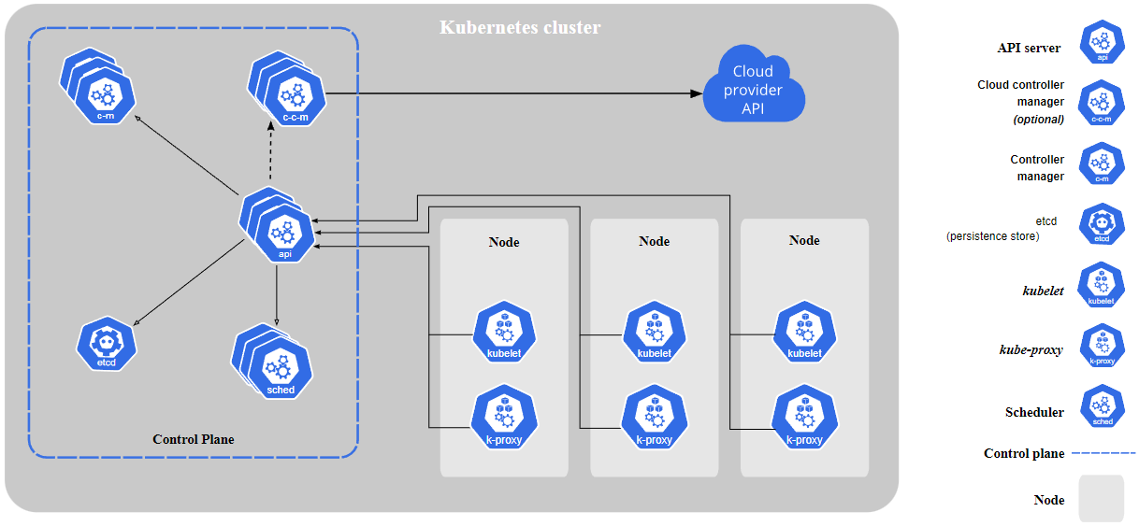
Kubernetes components
Notes:
Kubernetes cluster consists of a set of worker machines, called nodes, that run containerized applications. Every cluster has at least one worker node.
The worker node(s) host the Pods that are the components of the application workload. The control plane manages the worker nodes and the Pods in the cluster. In production environments, the control plane usually runs across multiple computers and a cluster usually runs multiple nodes, providing fault-tolerance and high availability.
Let's take a closer look at the components you can see on the right side of the picture.
kube-apiserver is a component of the Kubernetes control plane that exposes the Kubernetes API that controls cluster.
etcd is highly-available key value store used as Kubernetes' backing store for all cluster data.
kube-scheduler is component that watches for newly created Pods with no assigned node, and selects a node for them to run on.
kube-controller-manager is component that runs controller processes. Here I need to say what is controller – it is process that watches the shared state of cluster through the API server and makes changes attempting to move the current state toward the desired state.
cloud-controller-manager is component that embeds cloud-specific control logic. The cloud controller manager lets us link cluster into cloud provider's API, and separates out the components that interact with that cloud platform from components that only interact with our cluster.
kubelet is an agent that runs on each node in the cluster. It makes sure that containers are running in a Pod. The kubelet takes a set of pod’s specifications that are provided through various mechanisms and ensures that the containers described in those specifications are running and healthy.
kube-proxy is a network proxy that runs on each node in our cluster. This component maintains network rules on nodes. These network rules allow network communication to our Pods from network sessions inside or outside of the cluster. kube-proxy uses the operating system packet filtering layer if there is one and it's available. Otherwise, kube-proxy forwards the traffic itself.

Slide 6
Kubernetes network model
Example of communication of pods run on different nodes
Notes:
Every Pod in a cluster gets its own unique cluster-wide IP address. This means we do not need to explicitly create links between Pods and we almost never need to deal with mapping container ports to host ports.
This creates a clean, backwards-compatible model where Pods can be treated much like VMs or physical hosts from the perspectives of port allocation, naming, service discovery, load balancing, application configuration, and migration.
Kubernetes imposes the following fundamental requirements on any networking implementation:
pods can communicate with all other pods on any other node without NAT (network address translation)
agents on any node (for example system daemons, kubelet) can communicate with all pods on that node.
Kubernetes IP addresses exist at the Pod scope - containers within a Pod share their network namespace. This means that containers within a Pod can all reach each other's ports on localhost and they must coordinate port usage.

Slide 7
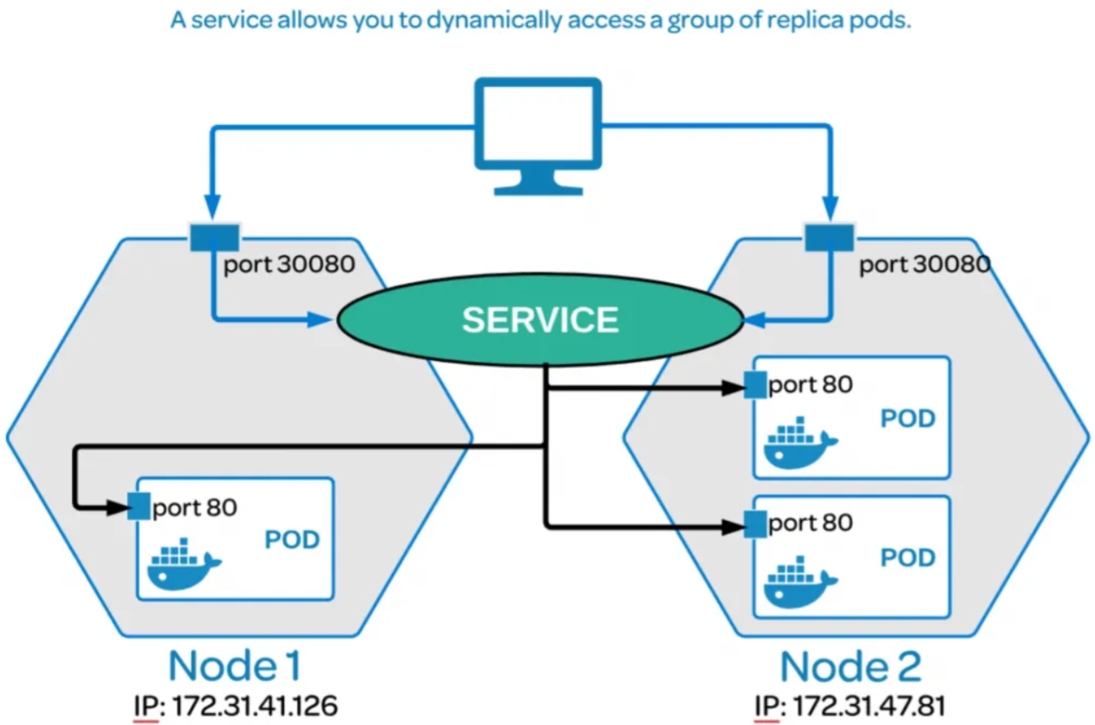
Service
Notes:
In Kubernetes, a Service is an abstraction which defines a logical set of Pods and a policy by which to access them. The set of Pods (so called ReplicaSet) targeted by a Service is usually determined by a selector.
With Kubernetes we don't need to modify our application to use an unfamiliar service discovery mechanism. Kubernetes gives Pods their own IP addresses and a single DNS name for a set of Pods, and can load-balance across them.

Slide 8
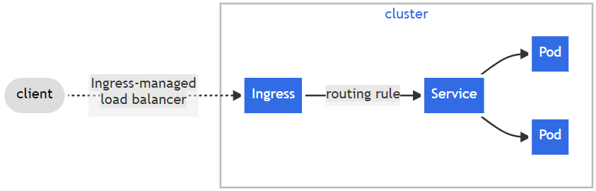
Ingress
Notes:
To apply load balancing we need to use ingress – an API object that manages external access to services in a cluster. Ingress exposes routes from outside the cluster to services within the cluster. Traffic routing is controlled by rules defined on the Ingress resource.
An Ingress may be configured to give Services externally-reachable URLs, different load balancing strategy, and other tasks.

Slide 9
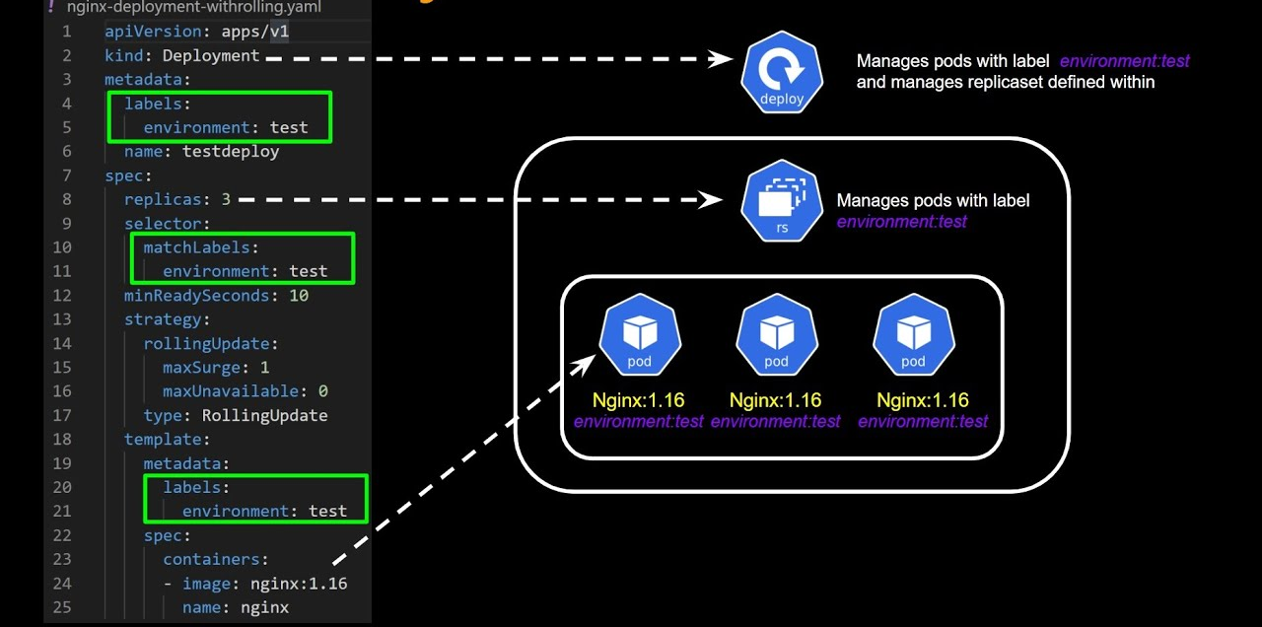
Deployment
Notes:
Deployment is a mechanism that provides declarative updates for sets of Pods.
We describe a desired state in a Deployment, and the Deployment Controller changes the actual state to the desired state at a controlled rate.
Typical use cases of this mechanism:
Create a Deployment to rollout a ReplicaSet. The ReplicaSet creates Pods in the background. Check the status of the rollout to see if it succeeds or not.
Declare the new state of the Pods by updating the Deployment. A new ReplicaSet is created and the Deployment manages moving the Pods from the old ReplicaSet to the new one at a controlled rate.
Rollback to an earlier Deployment revision if the current state of the Deployment is not stable.
Scale up the Deployment to facilitate more load.
Pause the rollout of a Deployment to apply multiple fixes and then resume it to start a new rollout.

Slide 10
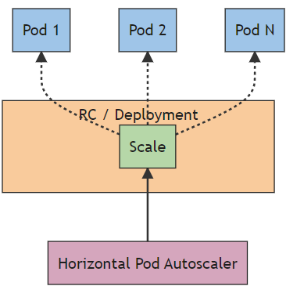
Horizontal pod autoscaling
Notes:
In Kubernetes, a HorizontalPodAutoscaler automatically updates a workload resource (for example Deployment) to be able to serve the current workload that is determined with specified metrics.
Horizontal scaling in Kubernetes means to deploy more Pods.
If the load decreases, and the number of Pods is above the configured minimum, the HorizontalPodAutoscaler instructs the workload resource to scale back down.

Slide 11
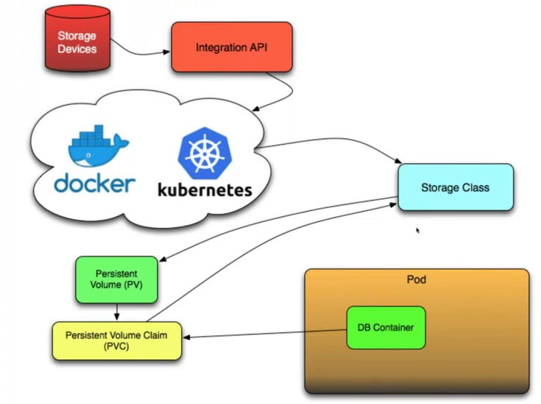
Storage
Notes:
On-disk files in a container are ephemeral, which presents some problems for non-trivial applications when running in containers. One problem is the loss of files when a container crashes. The kubelet restarts the container but with a clean state. A second problem occurs when sharing files between containers running together in a Pod. The Kubernetes volume abstraction solves both of these problems.
A pod can use any number of volume types simultaneously. Persistent volumes exist beyond the lifetime of a pod. When a pod ceases to exist Kubernetes does not destroy persistent volumes.
At its core, a volume is a directory, possibly with some data in it, which is accessible to the containers in a pod.
Kubernetes has PersistentVolume subsystem that provides an API for users and administrators that abstracts details of how storage is provided from how it is consumed. This subsystem provides cluster administrators with an ability to use large number of volumes that differ more than just in size and access mode.

